Slide 1
Drowsiness Detection System
Enhancing Road Safety
Shahzaib Rafi (2021-CS-2)

Slide 2
AGENDA
1
Overview
2
Literature Review
3
Methodology
4
Working
5
Acceptance Criteria
6
Conclusion

Slide 3
Overview
In a world highly dependent on road transportation, safety is paramount. Drowsy driving, a persistent threat, endangers lives and well-being. This project addresses this universal concern by developing an advanced AI system. This system identifies signs of driver drowsiness in real-time, using state-of-the-art computer vision techniques. The project encompasses diverse data collection, algorithm development, rigorous testing, and optimization for real-time processing. The goal is to create a transformative solution for safer roads, reducing accidents and injuries. Ultimately, vision extends to a future where AI-driven safety systems become standard in all vehicles, contributing to a healthier and more secure urban environment.

Slide 4
Literature Review

Slide 5
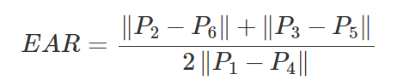
A Real-time Driving Drowsiness Detection Algorithm With Individual Differences Consideration
Focuses on Individual Differences
Introduces Parameter EAR (Eyes Aspect Ratio)
Invented DCCNN to detect face.

Slide 6
A Real-time Driving Drowsiness Detection Algorithm With Individual Differences Consideration
Two Modules:
Offline Training: Initialization process where person face is studied and EAR is calculated for both state (open and closed eyes.)
Online Monitoring: Live monitoring in real life where face detected by DCCNN and drowsiness calculated with help of previously calculated EARs

Slide 7
A Real-time Driving Drowsiness Detection Algorithm With Individual Differences Consideration
Limitations:
Initially requires learning of Driver’ facial feature.
Comparatively slower
Accuracy:
Researchers claimed 98.8% accuracy.

Slide 8
Real-Time river-Drowsiness Detection System Using Facial Features
Creation of MC-KCF Algorithm to fix drifting of face drift window.
It is used with MTCNN (old Algo), in case MC-KCF fails.
Decides if person is drowsy on basis of:
Eye closure per minute
Yawning per minute
Duration of eye closure
Frequency of blinking

Slide 9
Real-Time river-Drowsiness Detection System Using Facial Features
Limitations:
Does not consider individual differences.
Slight drop in accuracy in darker environments or in case of glass wearing.
Accuracy:
Researchers claimed 92% accuracy.

Slide 10
Survey Facts
A survey (by Mehran University researchers in October 2021) encompassed key motorways in country which are M1, M2, M3 to gain valuable insights into road accidents:
The primary factors contributing to accidents were vehicle conditions, drowsy driving, and untrained driving, collectively accounting for 31%

Slide 11
Methodology
Data Collection: Gather large dataset for system training.
Algorithm Development: Implement an algorithm using advanced computer vision techniques and utilizing adversarial attacks..
1
2
3
Training and Testing: Train the system, rigorously test for accuracy, and reduce false alarms.
4
Real-time Processing: Optimize the system for quick, accurate real-time alerts.

Slide 12
Working
Dataset Setup:
I used a dataset of about 4000 images, dividing it into training and cross-testing sets.
1
Training Process:
Models were trained on a dataset with open and closed eye images (2 classes) using Convolutional Neural Networks (CNNs). The training involved adjusting parameters to minimize binary cross-entropy loss.
2

Slide 13
Working
Cross-Testing:
Cross-testing was performed on a subset of images to assess model generalization.
3
Evaluation on New Data:
For final evaluation, entirely new images were used, providing a rigorous assessment of model performance on unseen data.
4

Slide 14
Working
Adversarial Attacks:
Models faced adversarial attacks (PGD, FGSM, DeepFool), involving perturbations to deceive the model.
5
Adversarial Training:
Models were trained on the original dataset plus adversarially generated samples, enhancing robustness to attacks.
6

Slide 15
Working
Data Augmentation:
During training, augmentation techniques like rotation and flipping increased dataset diversity.
7
Results and Analysis:
Evaluation metrics (accuracy, precision, recall, F-1 score) were used, with results presented in tables under different configurations.
8

Slide 16
Acceptance Criteria
The AI system can consistently and accurately detect signs of driver drowsiness.
The system operates in real-time with minimal latency, ensuring practical usability.
1
2
The AI system has been trained on a larger dataset to handle various driver behaviors and conditions.
3

Slide 17
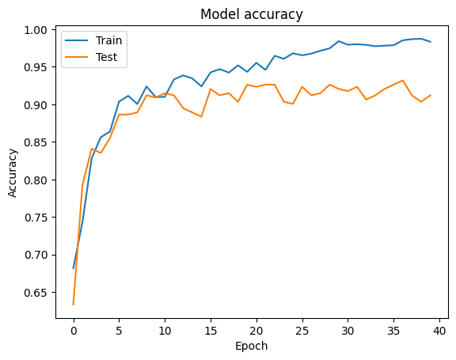
Without Augmentation

Slide 18
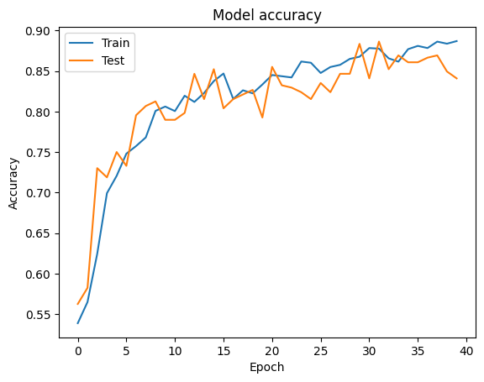
With Augmentation

Slide 19
Reasons for Lower Accuracy
Dataset Size Difference
One significant reason is the dataset size. I had only about 4000 images. A larger dataset can contribute to improved model performance.
1
2
GPU Availability in Google Colab
While running the code in Google Colab, I encountered the absence of the nvidia-smi command. The differences in GPU access between my local setup and Colab could potentially contribute to variations in the calculated factors.

Slide 20
Conclusion
In summary, this project aims to make the roads safer and protect drivers’ well-being.
The main goal is to create a smart AI system that can spot tired drivers to prevent accidents and Injuries. I wanted to tackle the widespread problem of drowsy driving and make roads safer for everyone. I hope for a future where all vehicles have AI safety features, making our cities healthier and more secure.

Slide 21
Thank you.

